Slide 1
All The President’s Men
SALES
V
Patrick McNeil / @unregistered436
Notes:
Alternate: In 1976, Dustin Hoffman and Robert Redford starred in the political thriller “All The President’s Men”, depicting the events of the 1972 Watergate Scandal and the resulting cover up by the Nixon administration. What is striking is the apparent number of insiders who knew about the cover up, but wouldn’t talk about it. I named my talk All The SALES President’s Men because while it’s not exactly a conspiracy, there is similar inside knowledge that remains unspoken and unconfirmed unless you’re part of a community run by a Sales President.

Slide 2

Notes:
As technologists and hackers many of us have skills in open source intelligence gathering or social engineering, but we might not stop to think about how those same skills are being used against us to influence our buying decisions.

Slide 3
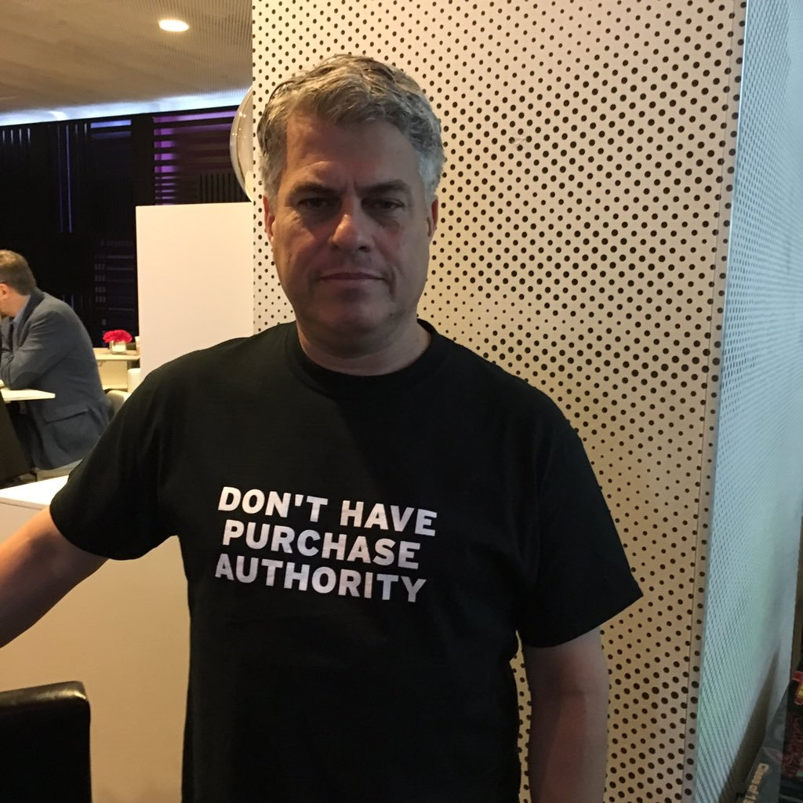
Notes:
You might not be the one with “purchasing authority”, but if you are technical you may be asked by the person with that authority to participate in a product evaluation, give requirements, or to make recommendations based on your expertise.
I believe that if you are aware of the tactics used through each phase of the sales process you can inoculate yourself against being taken advantage of and in some cases make vendors work for you.
That’s John B. Dickson at RSA this year

Slide 4

Notes:
Before I get started, I’d like you to think about the last evaluation or purchase process you were involved in, whether it was professional or personal. Think about the vendor interactions you had. Keep that experience in your head as I describe the common practices and tactics used throughout the sales process and hopefully you’ll be able to spot how they were used.

Slide 5

Notes:
I’m Patrick McNeil, and not that you’d know it, but I’m actually an introvert and an INTJ on the Meyers-Briggs scale. My wife calls me an absent minded professor because I can get completely consumed by things and can be oblivious to my surroundings. I have way too many browser tabs open in my brain and I’m afflicted by a backlog of technical projects.

Slide 6

Notes:
I should make it clear that I’m not speaking on behalf of my current employer today. I’ll also nod to my impostor syndrome and say that I may not be the MOST qualified person in the room on each individual topic I’m going to talk about, so if you’ve got something to share to add to my talk, please see me afterwards!

Slide 7
Me
Notes:
I’ll skip the detailed employment history since you can just look me up on LinkedIn, but I started my career as a programmer on IBM mainframes, UNIX systems, and PCs before transitioning into network engineering and eventually security. In 2006 I started working in a lab where I ran a team that evaluated vendors on a regular basis and started to recognize some of the tactics they were using. However it wasn't until I made my way into a Sales Engineering role in 2011, hired by one of the vendors I'd evaluated, that my eyes were opened. I've been a sales engineer for over six years now, so I've got the war stories, and I’ve been trained in several sales methodologies used by the three companies I’ve worked for in that time.

Slide 8

Notes:
I got the idea for this talk after I saw a sales prospect make what I thought was a horrible decision. They got sucked in by a sales tactic my competitor used and I wished I could have explained to them what had happened. My goal for this talk is to open YOUR eyes, too. I want give you some insight into what goes on in each phase of the sales cycle so you can spot the tactics being used.

Slide 9

Notes:
A lot of what I’m going to talk about you may have already suspected, so I’m here to confirm your suspicions. AND - I’m sorry, but as much as you may want me to, I’m not going to name specific vendor names, mostly just so I don’t get sued, but this talk is not really about bashing specific vendors.
I’m going to loosely organize the discussion into four major sections:

Slide 10
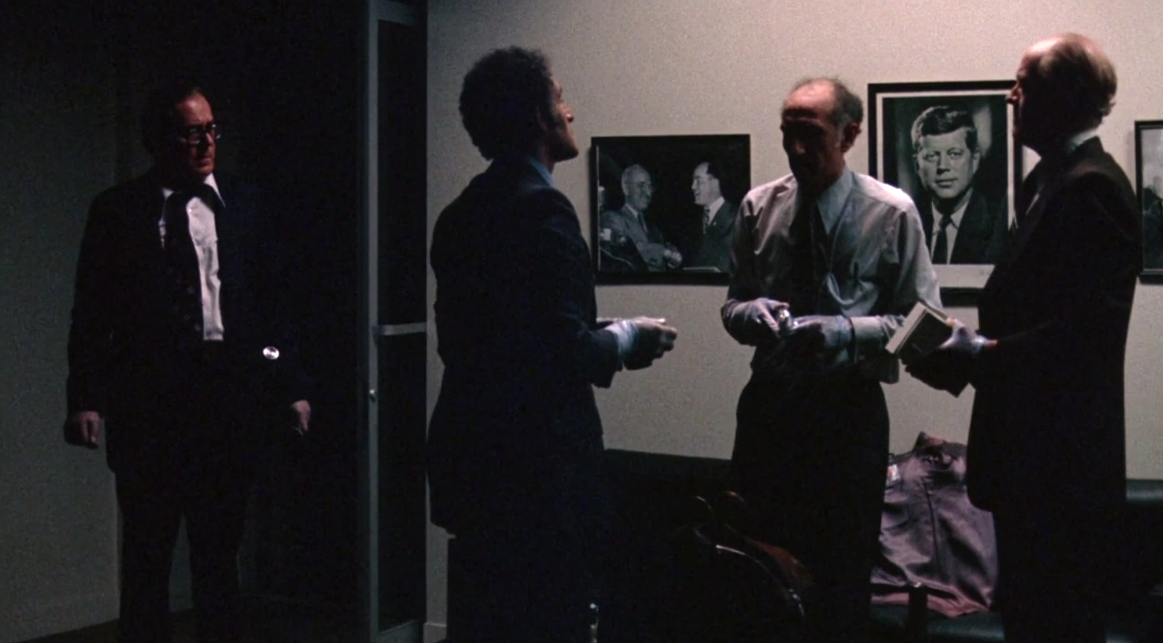
THE CONSPIRACY
Notes:
The Conspiracy - covering communication that starts at conferences, marketing you receive, and cold calls

Slide 11
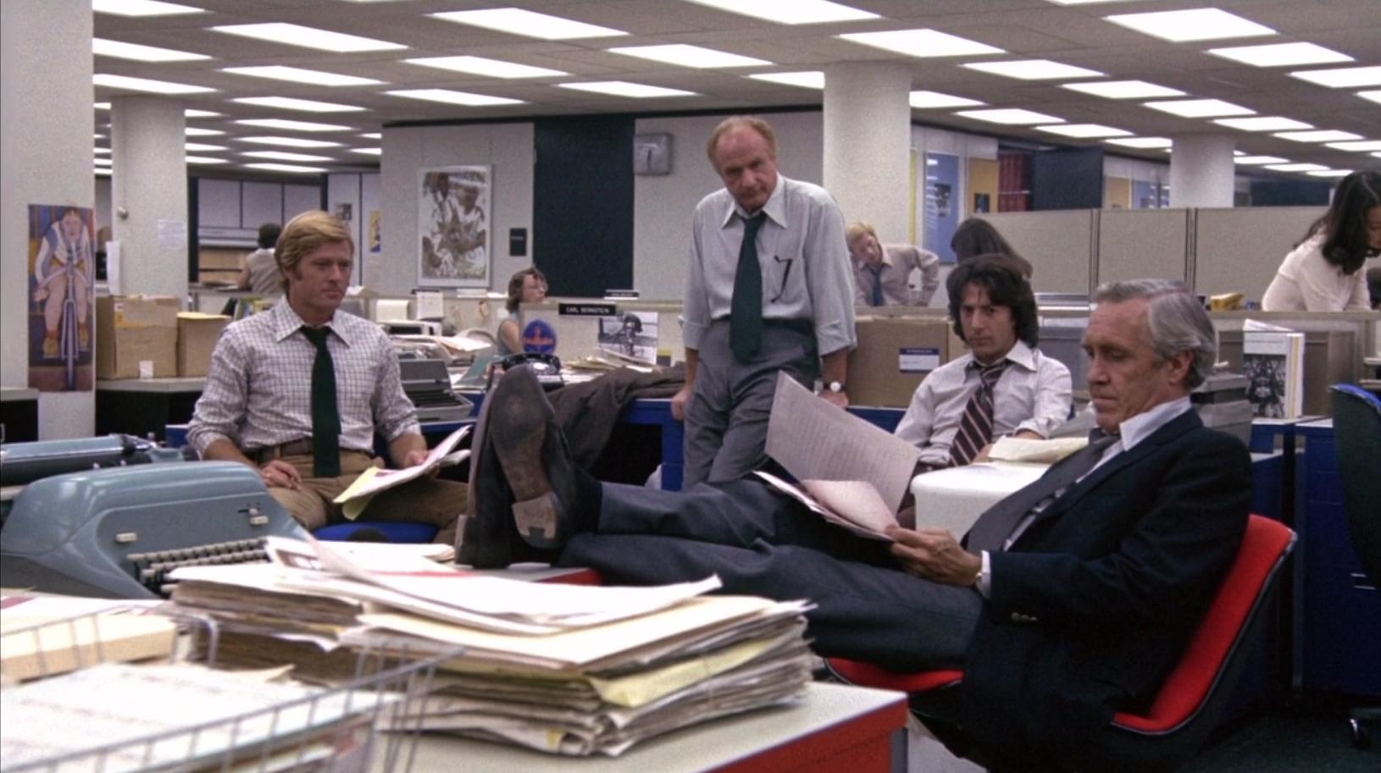
THE STORY
Notes:
The Story - The initial contacts by the sales team, competitive intelligence gathering, and the RFI/RFP process

Slide 12

THE INVESTIGATION
Notes:
The Investigation - when you bring the vendor in to conduct a PoC/PoV/Bakeoff and hear what they have to say about the product, vendor awards, and “independent testing”

Slide 13
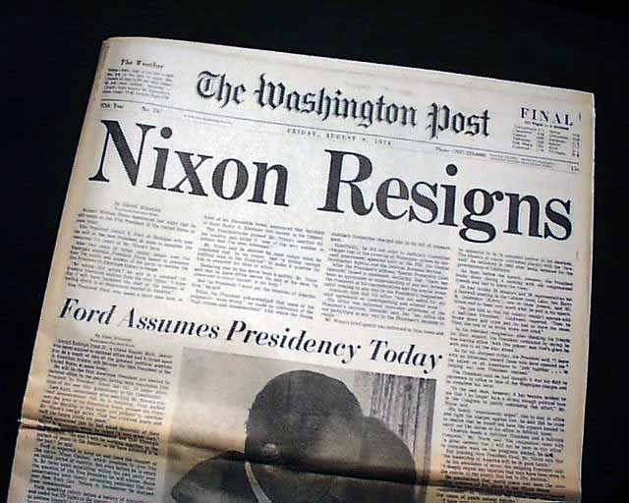
THE TRUTH
Notes:
The Truth - how to avoid making a bad decision

Slide 14

THE CONSPIRACY
Notes:
Your first contact with a vendor will normally be at a conference, as a result of marketing you receive like an email campaign, or from a "cold call". Let's look at each of these

Slide 15
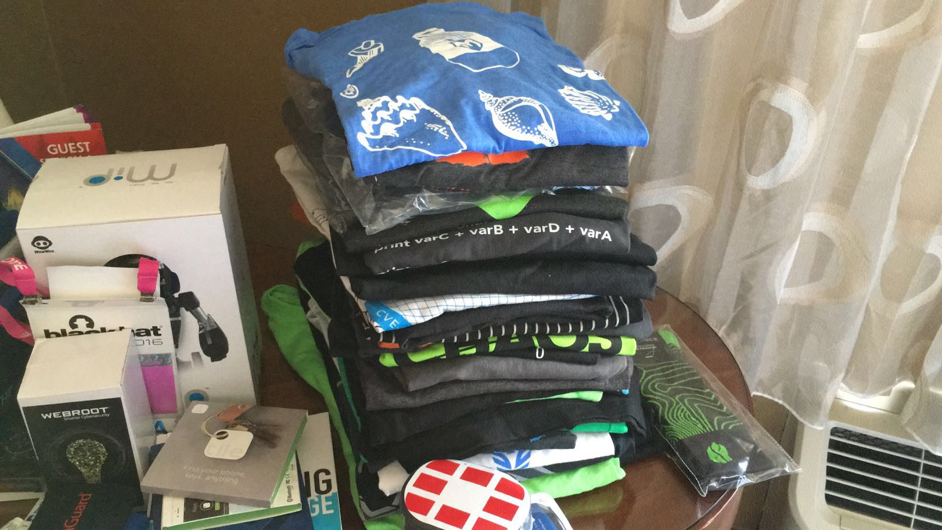
Notes:
Conferences are all about generating "leads" for the vendor, so they have prospects to sell to. it’s all about getting contact information, so booth "greeters" may be aggressive about scanning badges at a conference. Scanning your badge after a conversation or in exchange for some free SWAG is the currency of the day, but if greeters are in the aisles aggressively asking you "Can I scan your badge?" without even having a conversation that's a warning sign about their practices in my mind. I've even had people walk up and scan my badge without asking, and I actually made a scene at Black Hat three years ago when it happened to me. I was standing in line, and this sales guy came along and just “beep!” scanned my badge while I was talking to someone. It really pissed me off because he didn’t even bother asking!
Typically after a badge scan you are considered a "cold" prospect - someone to put on an email list or send some cheap targeted marketing until you engage more directly. If you had a good conversation with the person that scanned you they may “rank” you immediately from cold to hot.

Slide 16



Notes:
If you're serious about your scan privacy you can do a couple things.
One - submit "fake" data when registering. Make up a domain name that sounds like a business. Register it and use it for just these types of events. If you're required to include a phone number, you can always use something like a Google Voice number where you can block numbers if need be. It can be interesting to track which event is driving the vendor marketing campaign too. One quick way to do this is by creating email addresses on your domain for each event you go to. Gmail also lets you set up email aliases on your account so by using a new alias for a confernece you can see how your information was obtained.

Slide 17
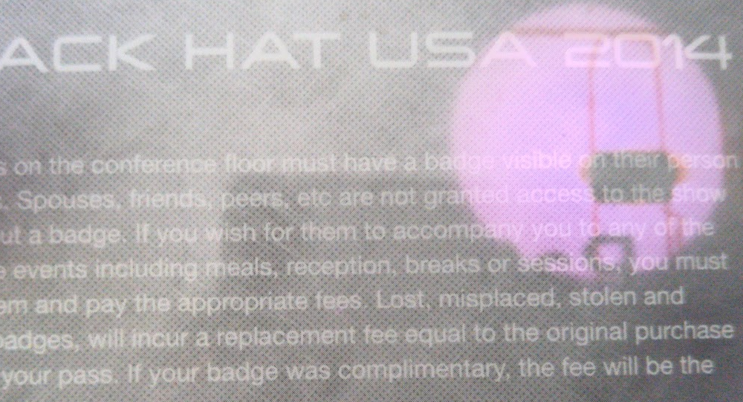
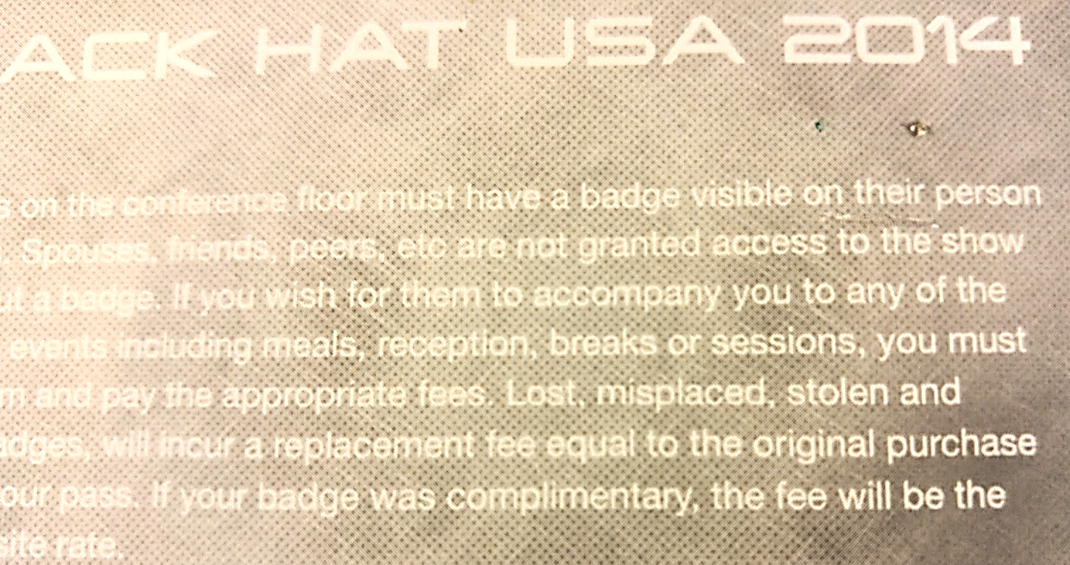
Failed murder attempt with a nail
Wires Marked
Exacto critical hit!
Notes:
Two - Protect your badge from being read without your permission, OR if you're not in the market to buy anything, modify your badge so it’s unreadable. If NFC badges are in use (like at Black Hat), you can put the NFC card in a RFID protective pocket or foil sleeve and only pull it out when you care to be scanned. A more destructive option is to kill the NFC chip. You can see here with the aid of a high power flashlight were the chip and inductive coil wires are on this old Black Hat badge. I tried killing this badge, scanning with my phone as I went. You can see where I marked the coil wires and tried putting a finishing nail through one. It didn’t seem to work. However a very small slit with an exacto knife through the center of the NFC chip effectively killed it and was far less noticeable.

Slide 18


BT|~NTkyNzQ1NTAxNzQ0MjM3MjkwMDAxfH5QYXRyaWNrfH5NY05laWx8flBtY25laWxAdmVyYWNvZGUuY29tfH4zMzkuNjc0LjI1MDB8flNvbHV0aW9ucyBBcmNoaXRlY3R8flZlcmFjb2RlfH41NTE4NQ==
Notes:
QR code badges used by some conferences are typically just read with an iPhone or Android application. Thse may also be rendered "unreadable" with extra dots from a fine tip Sharpie to create noise. Here’s my readable badge before with the base64 data string. AND - here it is afterwards in an unreadable state… Besides being not a great photo the difference is easy to see close up but not noticeably damaged from a foot or more away.

Slide 19

Notes:
If you want to go to the vendor party for free food or booze just know that if you use your Gmail or Yahoo address when you sign up you're likely to be waitlisted or denied either by automation or by a human screening the signups. Besides a good party, the point of the vendor event is to make contacts in a more informal setting than the booth. If you work for a targeted company it is not uncommon for the vendor to assign someone who covers your sales region to track you down for a conversation.
Cylance Twitter from RSAC 2017 - https://twitter.com/cylanceinc/status/830182070861365249

Slide 20

You are HERE
Notes:
If you're at the booth and are interested in a demo of the vendor's product you may need to get through the "greeter” or “screener” gauntlet first. It's their job to gauge your interest level and protect the the demo team since the number of knowledgeable engineers the vendor can bring to conferences is limited. If you do get a demo, your status might be bumped from cold to "warm" or "hot" depending on the conversation, and understand you are more likely to get a phone call asking to set up a meeting.

Slide 21
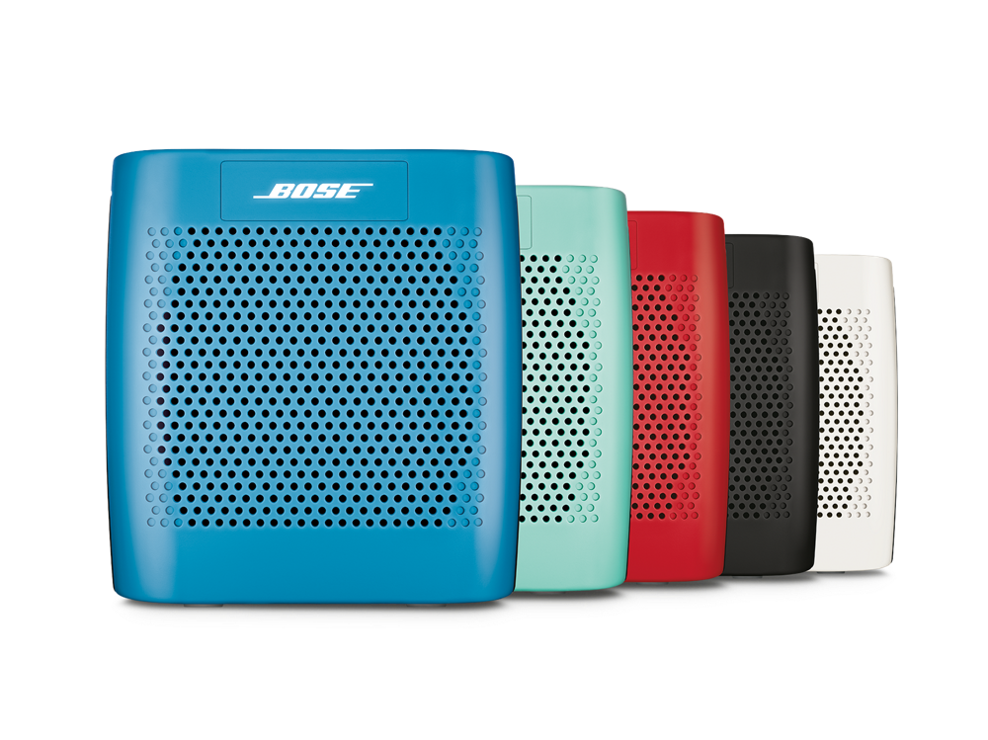

Notes:
Giveaways are NOT as random as you would hope. If you're not a warm or hot lead you're not likely to win. Yes, some vendors "cheat" this. They didn't publish rules saying it was truly random, did they?! If you are thinking that kickin' speaker or quad-copter is going to be yours off some random badge scan when you didn't talk to anyone, think again! The point is to generate good will with a potential prospect.

Slide 22

Notes:
Booths that have someone "mic'd up" are a personal peeve of mine. In some cases the person with the mic is just an actor who memorized a script filled with sound bites to grab your attention with Fear, Uncertainty, and Doubt (FUD). They really are carnival barkers who want to bring you in to see the miracle cure that the vendor is selling. I especially absolutely hate the ones that bring in magicians to give their pitch, and if you’ve been to RSA or Black Hat I know you’ve seen at least one of these people. This year, just walking around the show floor at RSA, one would have thought the sky was falling and the world was going to end. These are the booths I just walk right by. Yes, there ARE vendor presentations done in the larger booths where a subject matter expert is speaking with the benefit of amplification, so use your best judgement.

Slide 23





<img width="1" height="1" style="display:none" src="http://t.sidekickopen65.com/e1t/o/5/f18dQhb0S7ks8dDMPbW2n0x6l2B9gXrN7sKj6v5dz2YW2zhwTz8qSrY6Vd_RpW3LvrVvW2RgTmN1k1H6H0?si=5732826710409216&amp;pi=8b37b0c8-1087-49b1-850c-3fbaaaf6c780">
See that? Yeah, I don’t either.
Notes:
Most companies use some sort of email campaign software, and EVERY email you receive is tracked for engagement. If you allow HTML graphics they know you opened the email. Even emails that don’t appear to have graphics in them could have an embedded tracking dot called a web beacon like the one above.
Most email clients have some way to disable automatic download of web graphics if you want. If you click a link they know what you clicked and will customize communications to you moving forward. Links will track account number, email campaign, template that was used, and of course the specific contact.

Slide 24

Satellite NSEW orientation target, Tonopah Test Area, Nellis Bombing Range AFB, NV, USA
Notes:
When I started my last job search I was looking at more tech vendor websites than I usually do. I started seeing ads for ALL of these companies - including my employer at the time - injected into websites I was visiting like Facebook. The same thing happened when I was looking at auto parts on my wife’s computer. She wasn’t happy getting autozone ads. I’m sure most of you have some story where the marketing over-reach bordered on creepy.
Ads can be targeted to you in several different ways. Some of the ways this happens include:
Pixel based - where the site uses javascript to drop a cookie in your browser, and when you visit other sites where they’ve paid for ad time you’re served one of those ads.
List based - where a company pays the website you are on to show you their ads based on their email database
Account based - where ads are served to you based on your corporate IP range
Of course, if you go to a vendor’s site and register for a white paper download, that may transition you from a cold prospect to a warm one depending on your prior interaction. Expect a follow up email and potentially a call.

Slide 25
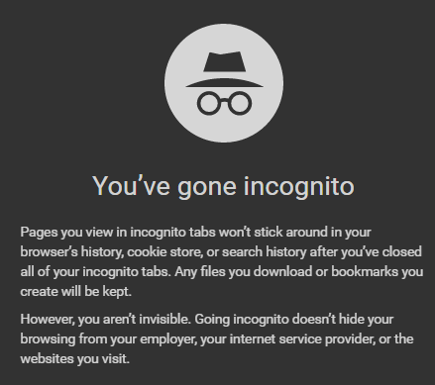

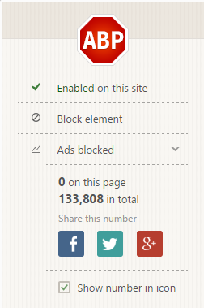
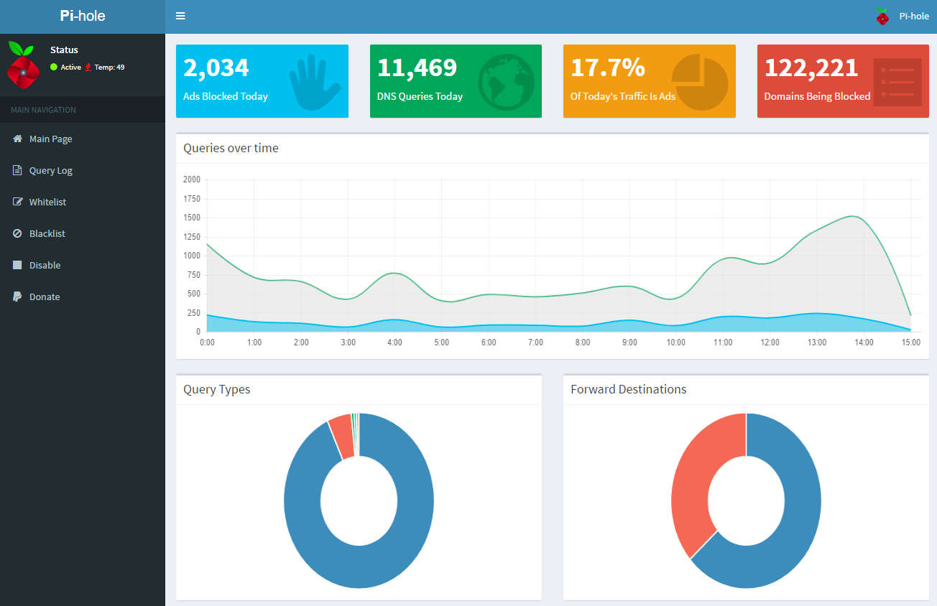
Notes:
If you want to avoid or minimize tracking there are a few things you can do:
a. Either don’t open vendor emails, make sure graphics in HTML emails are not automatically downloaded, or turn off HTML email altogether (screen shot in Outlook?)
b. Visit sites directly vs clicking on an email link
c. Use ad blockers, EFF privacy badger, DNS blackholing like pi-hole, etc
d. Use browser settings to block and/or delete cookies regularly
e. Use incognito or private browsing mode
f. Just sign up for things with a fake email address!
g. Bypass registration - Ever taken a look at the source code for the download registration on a whitepaper? I've actually seen some pages include the redirect destination so you can bypass registration completely and just download it. This came in handy when I was investigating the company that the founders of a previous employer had started. They’d done some roll-your-own website development and hadn’t thought that one through.

Slide 26

Notes:
The flip side of avoiding marketing trackers is that tracking can enable communications that are more relevant to YOU: I used to run a product security incident response team, and we used an email campaign platform for important customer notification emails. We could track who opened the email and who clicked to download the detailed notification, so we knew if an important customer hadn’t gotten the message we could ping their account team to make some personal contact.
If marketers are more targeted in reaching their audience, you actually get higher quality content. A friend of mine told me, “I’d rather see a Hak5 ad in my browser than an ad for diapers, but marketers can only do that if they track who you are. Amazon is also amazing and can make better book recommendations than my local store because they know a lot about me – and that’s a value add to me.”

Slide 27

Notes:
Now what about Cold Calls? We call them “cold” because when the term originated the person calling you supposedly had no information about you or whether you’re a potential customer. This hasn’t been true for quite some time in the security industry. Every sales team has a list of target companies assigned to them based on multiple profile factors from Hoovers or other corporate databases and they're looking for people that work for their targets.

Slide 28

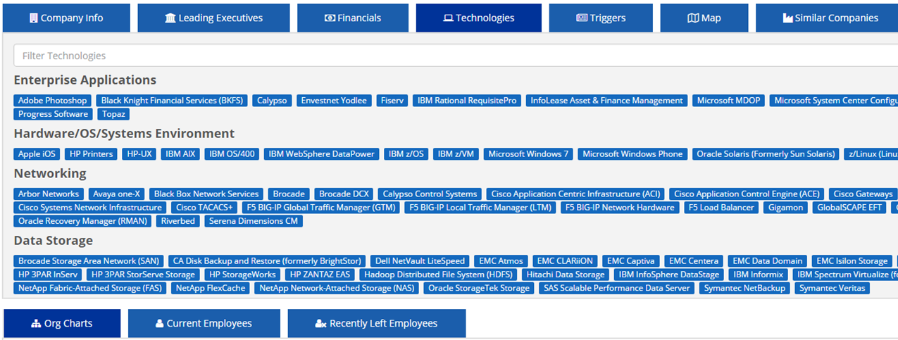
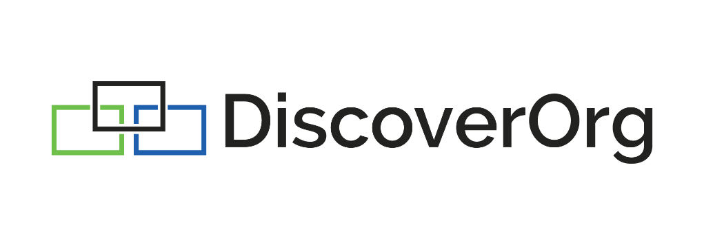

Notes:
Besides conference and website contacts, it's typical to use contact databases such as Data.com Connect (used to be Jigsaw), DiscoverOrg, LinkedIn, and others to find a contact’s details. (click) Some of these services will also scrape from job listings and take input from other salespeople who have worked with the organization to tell the subscriber some very specific internal details like organization structure, what systems they’ve purchased, and what they use in their software development lifecycle - from languages and build servers to orchestration.

Slide 29

Notes:
All of these criteria will be used to sort and filter whether a specific vendor will target you and/or which sales team will target you.
You will likely be categorized as a lead based on who you work for:
a. What is the annual revenue of your company?
b. Which region of the world do you live in / which part of the country?
c. Are you enterprise or carrier? In education or government?
d. Was there a news article about your company being breached recently?

Slide 30
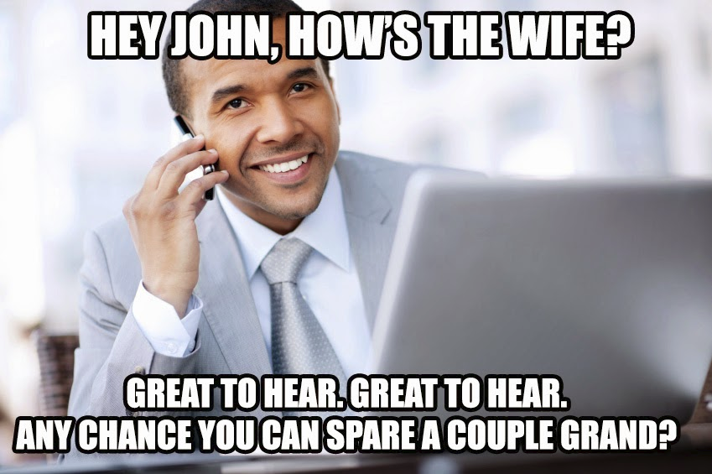
Notes:
Unless you are very senior, like C-level, your "first contact” cold call will likely be from some kind of business development representative (BDR). Before they call you, you've been looked up in more than one contact database as well as on LinkedIn and likely a few social media platforms. Some companies give their BDRs subscriptions and training on a couple services, and I even know one team that has their own custom tools. They want to know how to approach you and what interests of yours to bring up to get you to lower your guard and have a conversation. This is essentially a social engineering pretext! Their job is to find out whether you might be a buyer and to get you to agree to a meeting.

Slide 31
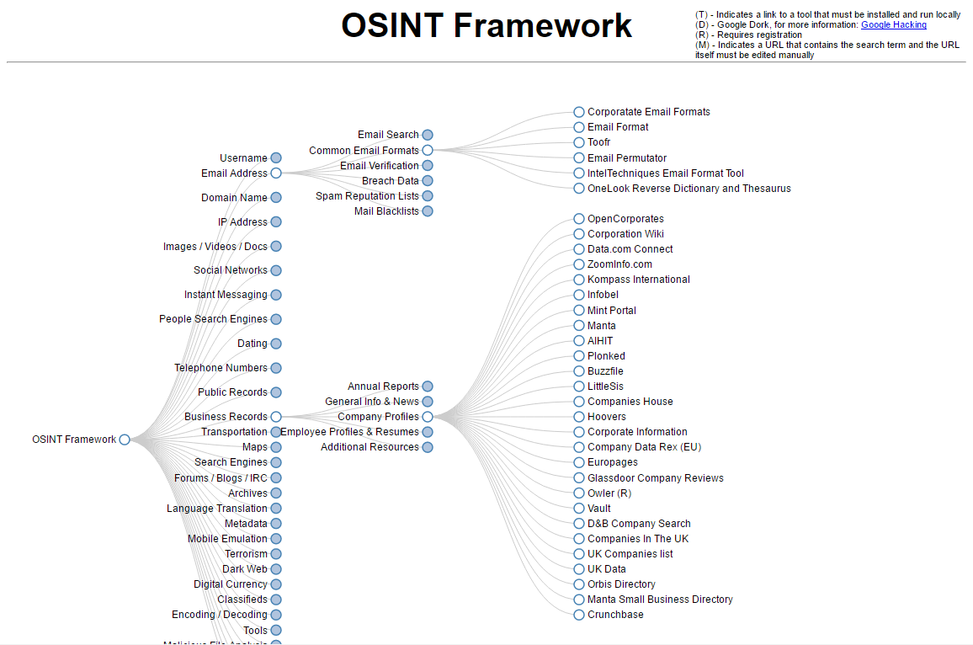
Notes:
Open Source Intelligence (OSINT) is used in the same way that "hackers" use it.
Just the other day I was trying to find the email address of someone who worked for a target company for my sales director. I used the osintframework.com site by Justin Nordine, and it led me to the email permutator which allowed me to build common email address formats based on my target’s name. Now, I could have included all those email addresses in the BCC field of ahackern email, but instead I went to https://haveibeenpwned.com/ and checked to see if any of those showed up. Sure enough, one of them DID, so that was obviously the real address! There are MANY other tools there that can be used to find out information about you - my prospect!

Slide 32
The Story

Slide 33

Starring: The Solutions Architect
Licensed to Sell
Notes:
If you actually schedule that first meeting you'll be handed off to an inside sales or field sales rep who is likely to bring along someone like myself - a "solutions architect“- otherwise known as a senior sales engineer. On the surface, my job is to discover your technical requirements and describe or demo to you how the products I’m trying to sell will meet those requirements. However as the “technical” guy, it’s also my job to build rapport with you, watch out for land mines sown by competitors, and perhaps plant a few of my own. I have to keep in mind numerous competitive capabilities, and practice a number of communications skills sometimes called a “sales methodology”.

Slide 34
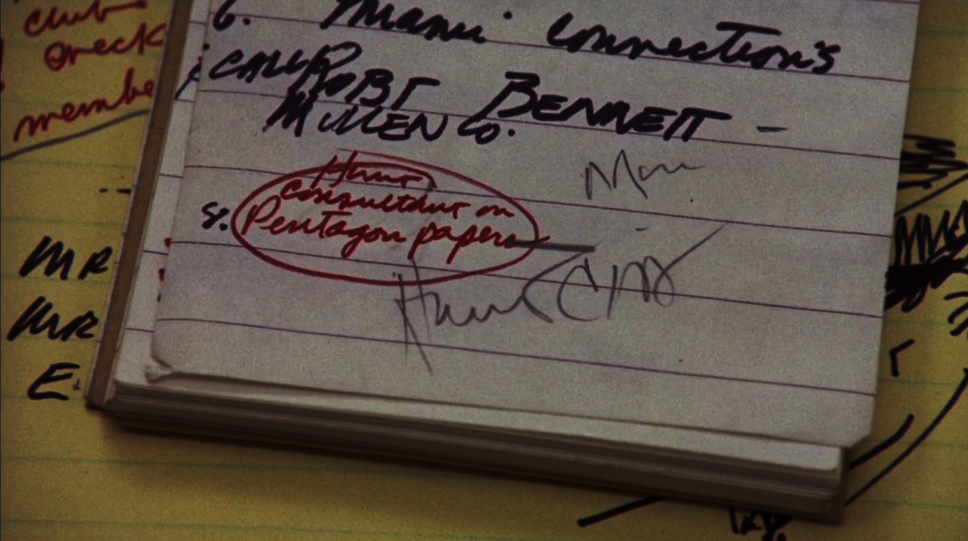
Sales Methodologies
Notes:
Sales methodologies are a set of techniques and skills that are based on the behaviors of successful salespeople. A specific methodology may be promoted within a company in an effort to make the sales team more effective and as a means of fostering the use of common terminology between their internal teams.
Most salespeople have been through some kind of training to identify personality types and to and build rapport based on what you say or do or what's on your desk. The kind of methodology the salesperson and company are using may speak to what their goal is or what type of company they are. Do you get the hard pitch about why you need something they're selling with lots of FUD? Or do they do a lot of consultative listening in the process to make sure they get to your requirements, then propose something that meets those requirements? Most sales methodologies are about trying to understand your pain points, your buying process and psychology, where you are in the "buying cycle", and what's going to motivate you to buy something. This sounds a bit like social engineering, right? Hopefully the salesperson you're dealing with will be more concerned with identifying what your requirements are, meeting them, and delighting you such that you continue to do business with them in the future.

Slide 35

Decoding the Methods
Question types:
Leading, Situation, or Problem
Open Ended
Control
Impact, Need-Payoff, or Implication
Summary
Notes:
One of my goals when I started researching this talk was to give you a decoder so you could tell what sales methodology the salesperson was using based on some of the common terms they were using. I looked at a variety of sales methodologies including the ones I was familiar with and some of the other industry leading ones that I wasn’t. (slide with Solution Selling, Customer Centric Selling, SPIN, NEAT, Sandler, Command of the Sale)
Unfortunately I failed at identifying specific terminology for many of them, at least not reliably, but did find that while they all had different ways of approaching things they all had a significant number of commonalities.
1. Leading, Situation, or Problem Questions to get you to the point where you admit your “pain points” OR to help you realize you have them and keep them in the forefront of your mind like “So how do you communicate your organizational risk to management?”, “How would you respond to a breach if it happened today?”, or “How much time do you spend on manual log analysis each day?”
2. Open Ended Questions - to get you to describe your problems, like “Can you describe your software development life cycle for me?”
3. Control Questions - to get specific information for required capabilities like “How many branch locations do you have?” or “Are you using a TAXII threat feed?”
4. Impact, Need-Payoff, or Implication questions to get you to discuss what could happen if you do or don’t solve your problem like: “If your developers were writing code free of security defects how much faster could you deploy releases?” OR “What was your estimated loss last year for those two breaches you didn’t detect?”
5. Summary – summarize and confirm what was just heard

Slide 36

Notes:
Sales methodologies can actually help you figure out what your requirements are as part of a consultative sale, so don’t misunderstand me and think I’m saying they’re “evil” in any way. You should still talk openly to vendors, being as honest as you can or they won’t get a complete picture of what you need. Just talk to several at the same time since each one of them can help you uncover a puzzle piece that helps you make your final decision with more information. Just be aware that some of the questions might blur the lines into social engineering.
Common social engineering tactics to get you to buy ARE built into many sales methodologies. Yes, sometimes aspects of these can actually benefit you, but it's mostly subtle psychology to get you to buy. Here are some of the social engineering tactics used:

Slide 37

Social Engineering Tactics
FOMO
Reciprocity
Success Criteria
Competitive Differentiation
Inoculation Effect
Instant Gratification
Left Digit Manipulation
Limited Options
FUD
Notes:
a. Fear of missing out “FOMO” - Pushing through action paralysis and using your “fear of missing out “FOMO” by setting limited time pricing or scarcity / exclusivity of the product.
b. Reciprocity - something for free like Blackhat tickets or free maintenance for two years - setting up a quid-pro-quo
c. Success Criteria - Getting agreement that once your success criteria are demonstrated that it's a "win". That way you feel uncomfortable if you don't award them the business. It's almost a quid-pro-quo. That said, you better KNOW your success criteria!
d. Competitive differentiation - showing how they're better or different, highlighting strengths and shortcomings, also pointing out competitor weaknesses
e. Inoculating a prospect (you) against tactics used by the presenting vendor’s competitors so you recognize the sales tactic the competitor is using and think it's shady, whether it actually is or not. This is also known as the "inoculation effect"
f. Promoting "instant gratification" through quick start / arrivals, fast shipping, turnkey services, etc.
g. Left digit manipulation - making the price look lower by manipulating the "left digit" - ex: 1999 vs 2000
h. Limited options - Providing flexibility but not too many options that will confuse you, pricing bundles make it easier to buy.
i. FUD! - sowing Fear, Uncertainty, and Doubt

Slide 38

Competitive Intelligence
Acquisition
Notes:
Competitive Intelligence is critical to the sales process in the same way that anyone going into battle needs to understand their enemy.
There are whole teams in some companies that build competitive intelligence from open sources. As you would expect, just about every company has a competitive intelligence database or battle cards that describe the capabilities of competitors. It includes the vendor strengths and weaknesses versus that specific competitor and typically predefined “trap questions" to get a prospect thinking about the competitor's products deficiencies. You can’t necessarily trust what you hear about a competitor from the vendor you are dealing with as their intelligence may be dated, or colored with their particular prejudice or lack of understanding.
How is this competitive intelligence gathered besides off the Internet?

Slide 39

Notes:
At conferences, booths are staked out by competitive intel gathering staff or product managers who listen to demos given to prospects and sometimes engage in direct conversation - sometimes overt, sometimes not. It’s crazy how much information you can directly get from a competitor that wants to tell you how much better their product is than yours!
New employees may bring with them old confidential material that they hand over, or discuss with their new employer.. Most companies have clauses about not keeping documents, but this is largely ignored with few repercussions. This isn’t the most ethical thing, but it happens.
Customers who have been called upon by the competition will sometimes share pricing and roadmaps from their competitors. This can be an attempt at leverage, but if you've developed a "champion" in the account this can just be because they're being "friendly". Seeing your product replaced means they made a poor decision previously.

Slide 40

Notes:
For a vendor’s most aggressive competitors it’s not unusual to acquire the competitor gear to test in a lab to uncover weaknesses or to determine what features you need to develop to match theirs. The competitor isn’t going to sell anything outright, so it’s typical to offer a highly discounted “swap-out” to a prospect where the vendor gets the competitor gear as a condition of the sale. Vendors may also go through a reseller partner who sells competing products or gray market vendors who sometimes sell fully licensed gear.

Slide 41

Notes:
Some of you might be required to buy through a Requests for Information or Requests for Proposal process mandated by your procurement department. That quick purchase of your favored vendor’s product just turned into a multi-week process of writing an RFP, evaluating proposals and testing the top contenders. This experience is not necessarily bad, especially if you know what your requirements are, and there IS a chance that you’ll uncover something you didn’t know.
The first vendor you deal with (or your favored vendor) will want to "help" you with the RFP if their sales team or SE has half a brain. The objective here is to produce a laundry list of items that all vendors should support as well as introduce trap-setting requirements. These are requirements that point out deficiencies (from the vendor perspective) in the competing vendor's solution. It’s up to you to weigh whether they ARE they deficiencies for you.

Slide 42
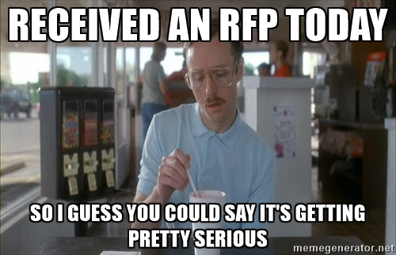
Notes:
You should know that Vendors HATE responding to RFPs as much as you hate writing them. Yes, they do. Mostly because sales needs interdepartmental participation to complete them as they are technical and involved. Most companies willing to reply to RFPs will have a defined process and standardized copies of necessary docs like Security Surveys and Certs to aid their effort. Not every vendor is going to respond to the proposal if the initial investment amount or future expansion opportunities are not worth the overhead of doing so. Don't count on the vendor with the best solution necessarily replying if the potential revenue isn’t large enough for them.

Slide 43
The Investigation
Notes:
Ok. So you got through the RFP process and you've selected your top vendors to evaluate. Our next phase is “The Investigation"

Slide 44
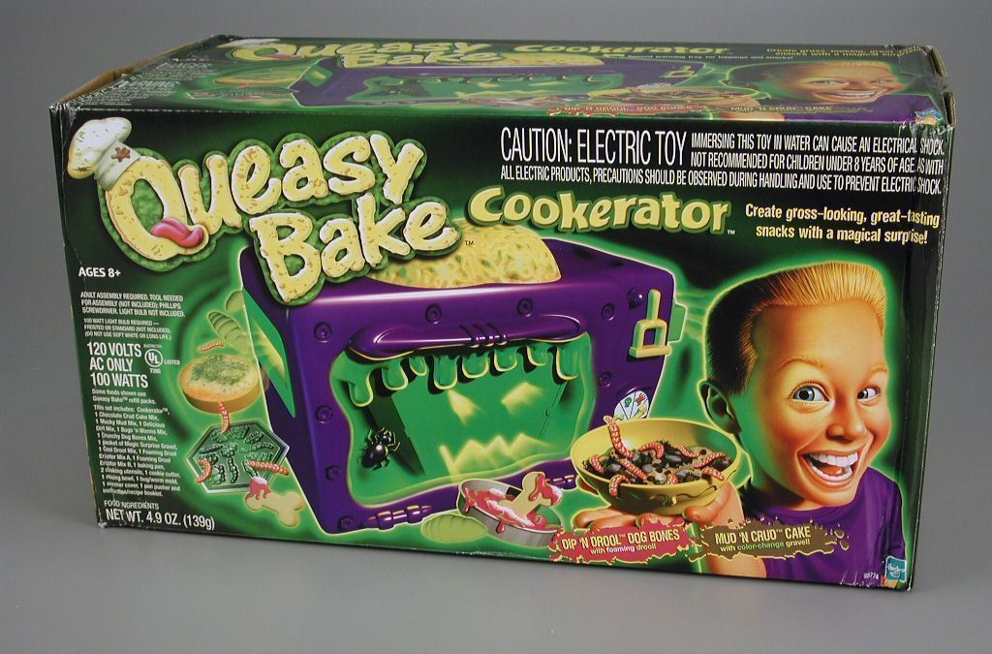
Securitay Edition
Jack Daniel Approved!
Notes:
Some people opt to do a “Bakeoff" or multi-vendor test, or sometimes just try their top vendor in a "Proof of Concept" or "Proof of Value"
But you have to ask- do you know much about the technology you’re attempting to select? We've all read up on a topic pretty quickly and gotten enough knowledge to be "dangerous". Our ability to read RFCs and technical papers serves us well for the most part, but we may miss some of the deep knowledge and corner-case stuff if we're new to a particular product category.
To come up with a test plan you may look at industry "studies" and ask a vendor or two for their recommendations, right?
Similar to RFPs, vendors who are on the ball will want to position their test plan. If you receive a test plan template from multiple vendors the differences may be where the vendor shortcomings *may* lie. Are those test cases realistic threats though? Are they things you really care about?

Slide 45
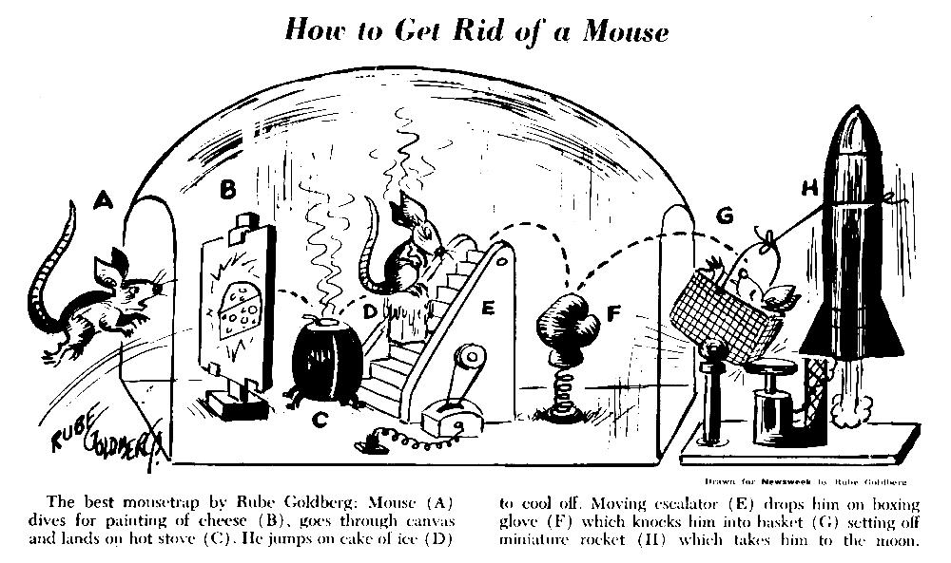
How to do Defense In Depth
Honeypot
Firewall Filters
Heuristic Classification Engine
IPS Ruleset
IP Blacklisting
“Attack Back”
Notes:
Demos and Proof of Concept testing are usually optimized (or sometimes rigged) to the best possible vendor scenario so they can be successful and done quickly in order to get to a sale. So ask yourself - if a test application, test tools, or generated test traffic was selected, who selected it and why? It may be legitimately hard to test a "real world" scenario so the vendor test can be a realistic compromise. Short of a full implementation try to check out third party stories and references, case studies, or introduce your own data sets and traffic where possible.
Yes, vendors actually optimize their code to produce the best results in specific industry tests or benchmarks, even if those tests are not realistic.. You may find their product doesn't perform like it did in the PoC when you get to the production implementation.

Slide 46

Aahhh…
It’s a Major Award!
Notes:
When you’re making your product selection sometimes it’s useful to refer to vendor awards, magazine awards, or research studies to determine who has a good product and who leads the market in vision, execution, reliability, etc. The dirty secret about these is that they are not always objective. How was the research funded? Who did the evaluations? Did the vendor have to pay to participate? In many cases to even participate in the study it’s “pay for play”, where the companies included pay fees. It’s hard for a small company with a great product to get in on this action.
Companies that sell the reports they produce to consumers tend to be a bit more objective than the reports directly funded by a vendor. However, if the evaluation was not done by an expert in the space they can fall victim to all the same competitive intelligence issues that you as a consumer will. Plus, the companies involved typically have the ability to review the report before it’s issued to “correct” any inaccurate information and do the best they can to spin any damaging information. Yes, the companies with top billing in an evaluation likely DO have a good product, but testing is not as independent as you might think. Any of the top few companies may all meet your needs, but also consider those not on the list.

Slide 47

Notes:
Some "independent test lab" studies are commissioned by a vendor because there isn’t a study reviewing their product category. Their goal is to prove that someone other than them tested and verified performance or features. In my personal experience, these test labs can be independent when dealing with "normal" stuff, but if the vendor has anything a little proprietary or outside of their norm they'll just ask the vendor for their test plan. The tests run may not represent what your real production requirements are. As a vendor, I've had to write the test plan, send a technician to build a system and execute the test plan, and the “lab” just wrote up a report of what we tested! In one instance I had one of these labs come back to me to tell me that another vendor beat my numbers and that they’d be willing to allow me to pay to re-test my product with the competitor test cases to try and show equivalent performance. They were practically blackmailing me into paying for another test event.

Slide 48

(Yes, every security conference deck must include this MEME at least once.)
Notes:
It’s not atypical for a vendor to tout a standards compliance item that may not really be important to you and make it sound like the other vendor is completely deficient if they don't have it. What if it doesn't really matter in your business? I used to hear "FIPS" being touted a lot, but it wasn't relevant for enterprise customers, and they weren't getting the specific hardware and software that made up the FIPS configuration anyways.
Some "Certifications" like Common Criteria, FIPS, or ICSA sound great on paper, but you really have to look at what was tested.
What was the scope of the testing? One vendor I used to work for achieved Common Criteria, but it was only for the administrative interface and didn't cover the actual services provided by the box.
Another vendor I used to work for had a competitor who bragged about their Common Criteria certification, but because there was no standard criteria for the device type a custom "target of evaluation" was created. The target was woefully incomplete and didn't survive the competitive lab testing that I did in-house. It was fun watching their primary AND HA boxes rebooting as the result of a single command.
A vendor’s marketing team will promote a certification, but these certifications are typically granted just for one specific release of hardware and software and does not carry over to the new releases that came out over the last YEAR or more that it took to get the certification.

Slide 49
The Truth
Notes:
After this long cautionary tale, working with a vendor without getting taken may seem like a daunting task. However, there are some things that you can do to avoid making a bad decision.

Slide 50

Notes:
Try to understand and rank your requirements before talking to a vendor. Talk to the end users to find out what they need and what real risks you are trying to manage. See if anyone on your team has background or experience in the product category. Know your critical requirements going in if you can, and use those to generate your evaluation criteria. You CAN listen to the vendors in the discovery process and you may learn about some requirements you hadn’t considered. As you discover new things just evaluate them independently.

Slide 51

Notes:
Talk about metrics in advance. How will you gauge whether the product is successfully doing what it's supposed to do in testing? In production? Do you have a way to measure its success externally, or must you rely on the vendor's report? That might be fine, but make sure they can support what you want to track.
If you care about a particular certification, ask to see a detailed report. Are there test cases defined so you can verify what was tested versus your requirements?

Slide 52

Operational Considerations
Configuration
Installation
Expansion
Capacity planning
Logging & Troubleshooting
Ease of repair
Patching & upgrades
Security notifications
Vulnerability reporting process
Backups
Remote access
Service and suppot
Common adoption issues (cultural or process)
Notes:
Besides seeing the product "working" in your lab, consider all of the operational requirements to make a product a success. If you don’t consider the whole process you’re accepting hidden challenges or operational cost.
configuration, installation, expansion, capacity planning, troubleshooting, ease of repair, patching and upgrades, security notifications and vulnerability reporting process, backups, remote access, and vendor services and support capabilities, and even cultural or process issues.

Slide 53

Notes:
Ask about product/feature roadmap, but keep in mind it's not uncommon for vendors to just say that their product has a feature now or in the "next release" that it never will. Ask for an official roadmap and insist on talking to product management if you feel that some of your critical requirements might be pushing the envelope. I’ve worked for vendors whose roadmap changed directions every couple of months based on who they were trying to sell to!
Lastly, you might check out some user communities or forums for the vendor, but keep in mind that this can be a double edged sword. Just like everywhere else on the Internet - people may want to promote, complain, or troll.

Slide 54
Notes:
OK - did everyone keep their last purchase process in mind? Did you have any insights into what techniques were used? I’ve just Inoculated you against the tactics used through each phase of the sales process, so take advantage of this new knowledge, and make the vendors work for YOU!
I’d love to hear stories of vendors good and bad, and any tactics they used or you used. So if you have any particularly entertaining stories You can find me in the common area in about 10 minutes.

